Slide 1
Accuracy Evaluation Process and Criteria

Slide 2
AGENDA
Overview
The Criteria
Total Accuracy
Final tips & takeaways

Slide 3
Overview
General Info
The following slides accompany the research study “Chain-of-Thought vs. Few-Shot: A Comparative Study of Prompting Strategies for Code Generation.” by K. Nobakhtfar, K. Çakılcı and R. Zilan
The study evaluates performance based on four primary metrics: prompt verbosity, response verbosity, cost, and accuracy.
The following slides provide a detailed breakdown of our accuracy criteria and its evaluation process.

Slide 4
Overview
About the Accuracy
The accuracy metric was further broken down into five sub-metrics: Factual Correctness, Reasoning Quality, Coherency & Clarity, Completeness, and Understanding Depth.
The model’s self-evaluation was considered unreliable.
Two human evaluators assessed the responses generated by the model.
The evaluation results are provided in the tasks' data files, as well as in the main Excel file in a comprehensive table.

Slide 5
Overview
The Accuracy Evaluation Process
Each evaluator evaluated the responses independently.
Each response is evaluated across several criteria.
Each criterion is rated on a 1–5 scale (1 = Poor, 5 = Excellent).
The Weighted Total Accuracy is calculated for each evaluation separately.
The Weighted Total Accuracy is based on the scores given by the evaluator and the associated weight of each criterion.
Short notes may also be included for qualitative comparison.

Slide 6
The Criteria

Slide 7
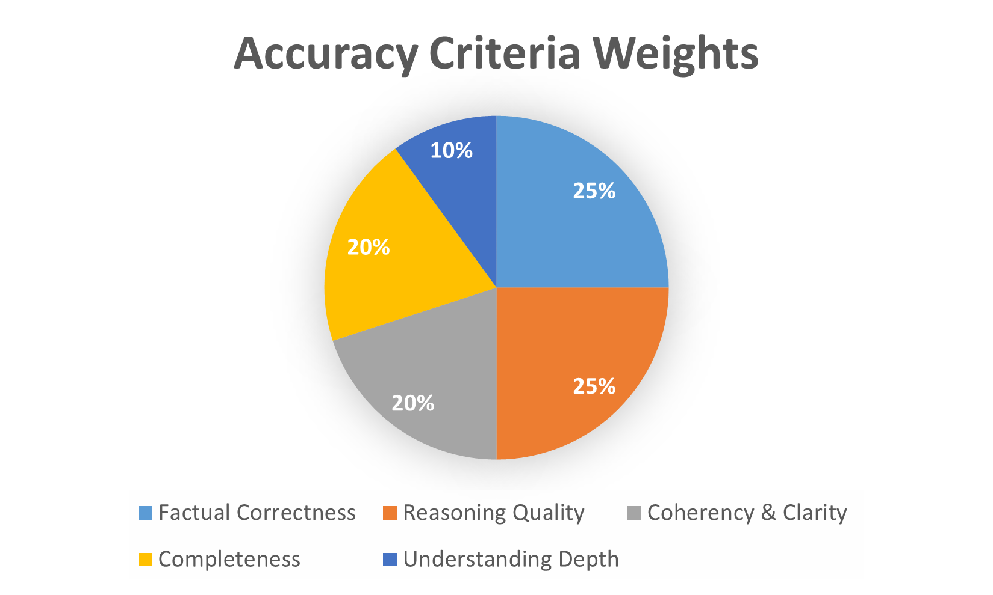

Slide 8
Factual Correctness
Score | Descriptor
5 | All key facts and steps are accurate; no incorrect statements.
4 | Minor factual inaccuracies that do not affect the main conclusion.
3 | Some incorrect or missing details, but overall understanding is evident.
2 | Multiple factual errors that affect reasoning or conclusion.
1 | Major factual misunderstanding or wrong final answer.
Weight: 25%
Evaluates the extend to which the generated response is factually accurate.

Slide 9
Reasoning Quality
Score | Descriptor
5 | Logical, step-by-step reasoning; clearly justified transitions between steps.
4 | Mostly logical with slight jumps or assumptions.
3 | Reasoning somewhat unclear; some unsupported claims.
2 | Disorganized reasoning with major logical gaps.
1 | No coherent reasoning or explanation present.
Weight: 25%
Assesses the logical coherence and justification of the reasoning steps presented in the response.

Slide 10
Coherency & Clarity
Score | Descriptor
5 | Argument flows smoothly; easy to follow; clear language.
4 | Mostly coherent; minor clarity issues.
3 | Understandable but scattered or repetitive.
2 | Difficult to follow due to poor structure or phrasing.
1 | Incoherent or unreadable.
Weight: 20%
Measures the overall coherence, clarity, and organization of the generated response.

Slide 11
Completeness
Score | Descriptor
5 | Covers all aspects of the question thoroughly.
4 | Slightly incomplete but captures key points.
3 | Several missing elements or examples.
2 | Major omissions; partial answer.
1 | Severely incomplete or off-topic.
Weight: 20%
Evaluates the extend to which the response addresses all required aspects of the prompt.

Slide 12
Understanding Depth
Score | Descriptor
5 | Demonstrates deep insight or advanced understanding.
4 | Good understanding with some original thought.
3 | Surface-level explanation, limited elaboration.
2 | Shallow or formulaic response.
1 | Minimal understanding displayed.
Weight: 10%
Assesses the depth of conceptual understanding demonstrated in the response.

Slide 13
Total Accuracy

Slide 14

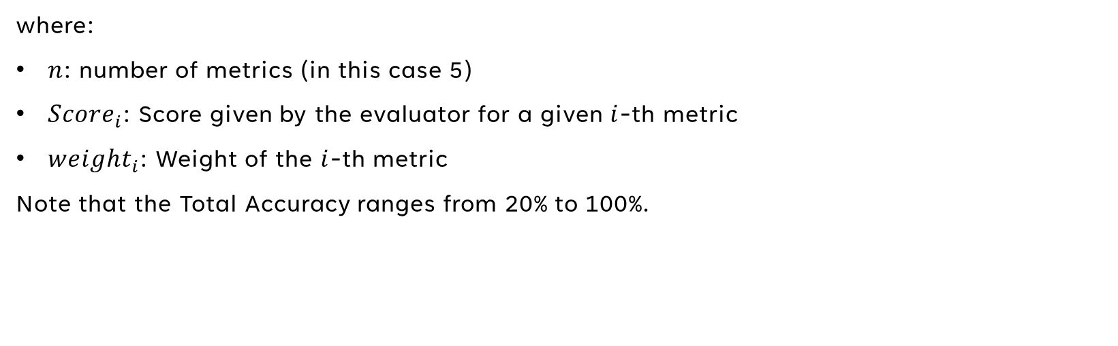
Total Accuracy Calculation
$$Total Accuracy=\frac{\sum_{i=1}^{n}{({Score}_{i}×{weight}_{i})}}{5}×100$$
where:
$n$: number of metrics (in this case 5)
${Score}_{i}$: Score given by the evaluator for a given $i$-th metric
${weight}_{i}$: Weight of the $i$-th metric
Note that the Total Accuracy ranges from 20% to 100%.

Slide 15
Total Accuracy Ranges
Range | Descriptor
90% - 100% | Excellent response demonstrating mastery.
70% - 89% | Strong response with few weaknesses.
50% - 69% | Average performance with noticeable issues.
30% - 49% | Weak, inconsistent, or flawed response.
20% - 29% | Unsatisfactory or irrelevant.

Slide 16
Final tips & takeaways
Inter-rater Reliability
Inter-rater reliability may be useful to assess the degree of agreement between evaluators.
Some potentially useful coefficients:
Cohen’s Kappa Coefficient (for exactly 2 evaluators)
Fleiss’s Kappa Coefficient (for more than 2 evaluators)
Intraclass Correlation Coefficient (ICC)
Spearman’s Rank Correlation Coefficient (Spearman’s ρ)
ANOVA was used to give an estimate for the inter-rater reliability.
Keep in mind that even though the criteria is clear, the evaluations may be subjective.

Slide 17
THANK YOU
Chain-of-Thought vs. Few-Shot: A Comparative Study of Prompting Strategies for Code Generation
Koorosh Nobakhtfar
Kenan Çakılcı
Ruken Zilan

